Slide 1


Slide 2



JDBC CONECTIONS
IN
JAVA

Slide 3

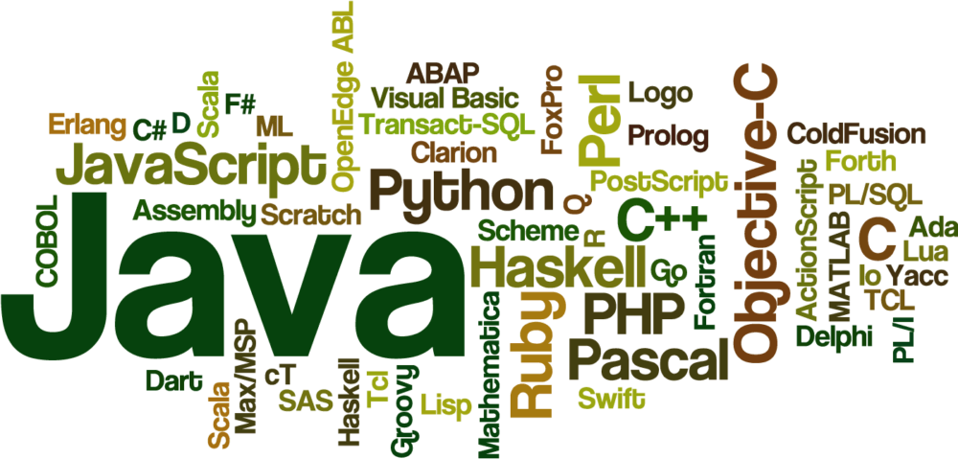


Slide 4
Create the Statement object
The createStatement() method of Connection interface is used to create statement.
The object of statement is responsible to execute queries with the database
Statement stmt=con.createStatement();

Slide 5
Execute the query
The executeQuery() method of Statement interface is used to execute queries to the database.
This method returns the object of ResultSet that can be used to get all the records of a table

Slide 6
EXAMPLE:
ResultSet rs=stmt.executeQuery("select * from emp"); while(rs.next()){ System.out.println(rs.getInt(1)+" "+rs.getString(2)); }

Slide 7
Close the connection object
By closing connection object statement and ResultSet will be closed automatically.
The close() method of Connection interface is used to close the connection.
con.close();

Slide 8
Java Database Connectivity with Oracle
To connect java application with the oracle database, we need to follow 5 following steps.
Driver class
Connection URL
Username:
Password

Slide 9
Java Database Connectivity with Oracle
Driver class: The driver class for the oracle database is oracle.jdbc.driver.OracleDriver.
// driver class for the MYSQL database com.mysql.jdbc.Driver.
Connection URL: The connection URL for the oracle10G database is jdbc:oracle:thin:@localhost:1521:xe where jdbc is the API, oracle is the database, thin is the driver, localhost is the server name on which oracle is running, we may also use IP address, 1521 is the port number and XE is the Oracle service name.

Slide 10
Java Database Connectivity with MYSQL
Driver class: The driver class for the mysql database is com.mysql.jdbc.Driver.
Connection URL: The connection URL for the mysql database is jdbc:mysql://localhost:3306/sam where jdbc is the API, mysql is the database, localhost is the server name on which mysql is running, we may also use IP address, 3306 is the port number and sam is the database name. We may use any database, in such case, we need to replace the sam with our database name.

Slide 11
Java Database Connectivity with MYSQL
Username: The default username for the mysql database is root.
Password: It is the password given by the user at the time of installing the mysql database. In this example, we are going to use root as the password.

Slide 12
Java Database Connectivity with Oracle
Username: The default username for the oracle database is system.
Password: It is the password given by the user at the time of installing the oracle database.

Slide 13
Create a Table
Before establishing connection, let's first create a table in oracle database. Following is the SQL query to create a table.
create table emp(id number(10),name varchar2(40),age number(3));
To connect java application with the Oracle database ojdbc14.jar file is required to be loaded

Slide 14
LOGIC: ORACLE
import java.sql.*; class OracleCon{ public static void main(String args[]){ try{ //step1 load the driver class Class.forName("oracle.jdbc.driver.OracleDriver"); //step2 create the connection object Connection con=DriverManager.getConnection( "jdbc:oracle:thin:@localhost:1521:xe","system","oracle"); } | //step3 create the statement object Statement stmt=con.createStatement(); //step4 execute query ResultSet rs=stmt.executeQuery("select * from emp"); while(rs.next()) System.out.println(rs.getInt(1)+" "+rs.getString(2)+" "+rs.getString(3)); //step5 close the connection object con.close(); }catch(Exception e){ System.out.println(e);} }
Notes:
Here, system and oracle are the username and password of the Oracle database.

Slide 15
CREATE A TABLE
create database sam; use sam; create table emp(id int(10),name varchar(40),age int(3));

Slide 16
LOGIC: Connect Java Application with mysql database
import java.sql.*; class MysqlCon{ public static void main(String args[]){ try{ Class.forName("com.mysql.jdbc.Driver"); Connection con=DriverManager.getConnection( "jdbc:mysql://localhost:3306/sam","root","root"); //here sam is database name, root is username and password Statement stmt=con.createStatement(); ResultSet rs=stmt.executeQuery("select * from emp"); while(rs.next()) System.out.println(rs.getInt(1)+" "+rs.getString(2)+" "+rs.getString(3)); con.close(); }catch(Exception e){ System.out.println(e);} } }

Slide 17
Connectivity with Access without DSN
There are two ways to connect java application with the access database.
Without DSN (Data Source Name)
With DSN

Slide 18
LOGIC:Connect Java Application with access without DSN
import java.sql.*; class Test{ public static void main(String ar[]){ try{ String database="student.mdb";//Here database exists in the current directory String url="jdbc:odbc:Driver={Microsoft Access Driver (*.mdb)}; DBQ=" + database + ";DriverID=22;READONLY=true"; | Class.forName("sun.jdbc.odbc.JdbcOdbcDriver"); Connection c=DriverManager.getConnection(url); Statement st=c.createStatement(); ResultSet rs=st.executeQuery("select * from login"); while(rs.next()){ System.out.println(rs.getString(1)); } }catch(Exception ee){System.out.println(ee);} }}

Slide 19
Connect Java Application with access with DSN
import java.sql.*; class Test{ public static void main(String ar[]){ try{ String url="jdbc:odbc:mydsn"; Class.forName("sun.jdbc.odbc.JdbcOdbcDriver"); Connection c=DriverManager.getConnection(url); Statement st=c.createStatement(); ResultSet rs=st.executeQuery("select * from login"); while(rs.next()){ System.out.println(rs.getString(1)); } }catch(Exception ee){System.out.println(ee);} }}

Slide 20

THANK YOU

